Slide 1
Class – I B.Sc. Botany
Sub: Plant Anatomy
Topic: Plant Cell Wall
Teacher : Dr .Venu Gopal S

Slide 2
CELL WALL

Slide 3
A novelty song of more than 50 years ago listed food items the writer said he disliked.
Each verse ended with the line, “I like bananas because they have no bones!”
Indeed, bananas and all plants differ from larger animals in having no bones or similar internal skeletal structures.
Yet large trees support branches and leaves weighing many tons.
They can do this because most plant cells have either rigid walls that provide the support afforded to animals by bones or semi-rigid walls that provide flexibility.
At the same time, the walls protect delicate cell contents within.
When millions of these cells function together as a tissue, their collective strength is enormous.
The redwoods and Tasmanian Eucalyptus trees, which are the largest trees alive today, exceed the mass and volume of the largest land animals, the elephants, by more than a hundred times.
The wood of one giant redwood tree could support the combined weight of a thousand elephants.
The first cell structure discovered by Robert Hooke in 1665 was the cell wall, and among plant cell structures observed with a microscope, the cell wall is the most obvious because it defines the shape of the cell.
Many of the prepared specimens observed with a microscope in plant biology are merely stained remnants of once-living cells.

Slide 4
The cells of blue green algae, bacteria, fungi and plants have a cell wall just outside the plasma membrane.
This feature distinguishes them from animal cells, which do not have an organized cell wall.
Cell wall is a secretion product of the cell.
It affords support and protection to the cell and gives shape and rigidity to the plant body.

Slide 5
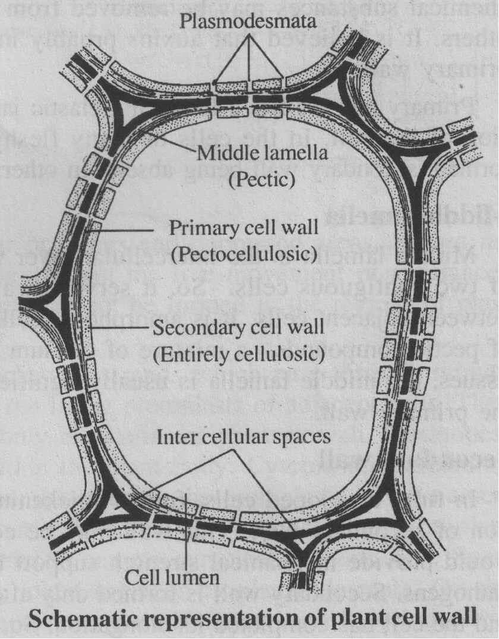

Slide 6
Chemical composition
Cell wall is formed mostly of polysaccharides.
It has two portions, namely an amorphous and less crystalline matrix (ground substance) and a system of semicrystalline microfibrils, embedded in the matrix.
The matrix is formed of hemicelluloses (e.g. xylans, mannans, galalctans and arabinans), pectic compounds (mainly calcium pectate and magnesium pectate), proteins, lipids, waxes, mucilages and biological plastics (such as lignin, cutin and suberin).
Microfibrils form the structural framework of cell wall.
In most cases they are formed of cellulose.
But, in yeasts and some fungi cell wall is formed of chitin, in some algae by xylans, and in still others by mannans
Cellulose molecules are long and unbranched chains, formed of glucose units.
Cellulose microfibrils give the cell wall compactness, tensile strength and plasticity.

Slide 7
The main structural component of cell walls is cellulose, which is composed of 100 to 15,000 glucose monomers in long chains, and is the most abundant polymer on earth.
As a primary food source for grazing animals and at least indirectly for nearly all other living organisms, it could be said that most life on earth relies directly or indirectly on the cell wall.
Humans also depend on cell walls because they provide clothing, shelter, furniture, paper, and fuel.
In addition to cellulose, cell walls typically contain a matrix of hemicellulose (a gluelike substance that holds cellulose fibrils together), pectin (the organic material that gives stiffness to fruit jellies), and glycoproteins (proteins that have sugars associated with their molecules)

Slide 8
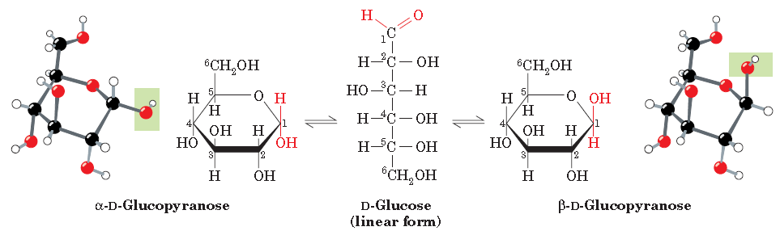
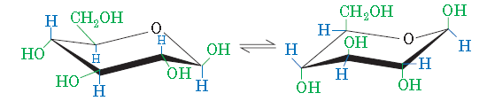
Notes:
The two anomers of D-glucose have slightly different physical and chemical properties, including different optical rotations (Section 4-2). The
anomers freely interconvert in aqueous solution, so at equilibrium,D-glucose is a mixture of the anomer (63.6%) and the anomer (36.4%). The linear form is normally present in only minute amounts.
Of the two possible chair conformations, the one that predominates is the one in which the bulkiest ring substituents occupy equatorial positions rather than the more crowded axial positions In the conformation on the left, which predominates, the relatively bulky OH and CH2OH substituents all occupy equatorial positions, where they extend alternately above and below the ring. In the conformation on the right (drawn in ball-and-stick form in Fig. 8-4, right), the bulky groups occupy the more crowded axial (vertical) positions.

Slide 9
Cellulose
β-D-anhydroglucopyranose units linked by (1,4)-glycosidic bonds
Notes:
It is well established that cellulose is a linear chain-like extended homopolymer with a macromolecular structure of β-D-glucopyranose units linked by (1, 4) glycosidic bonds.
On the basis of X-ray crystallography and nuclear magnetic resonance studies, it isestablished that the β-D-glucose units exist in the lowest energy ⁴C₁-chair conformation.
Furthermore, it is established that cellobiose is the repeat unit in cellulose, in which each cellobiose unit is 10.3Å long in which each anhydroglucopyranose residue is displaced 180º with respect to its neighbor, the result is a two-fold screw axis.
In addition cellulose exhibits by functionality, in that it processes a reducing (aldehyde) and nonreducing (2º alcohol) end groups.

Slide 10
Cell wall formation
Cell wall is formed during the telophase stage of cell division.
The presence of nucleus is necessary for wall formation.
During nuclear division, barrel-shaped body appears at the equator of the spindle.
It is called phagmoplast.
Inside it, several membrane-bound and fluid-filled vesicles are formed, probably from Golgi bodies or endoplasmic reticulum.
They fuse together and form a semi-fluid cell plate.
Cell plate extends sideways at both ends until it reaches the existing cell walls.
Fully formed cell plate serves as a complete partition inside the cell, called middle lamella.

Slide 11
Elements of endoplasmic reticulum get incorporated into the cell plate at intervals marking the positions of future plasmodesmata.
But, middle lamella is composed of pectic substances.
The middle lamella which is often called the intercellular substance holds together the primary walls of adjacent cells – cementing material.
It can be dissolved by various substances, including the enzyme pectinase.
The cells on the sides of the middle lamella synthesise and deposit over it cellulose hemicelluloses and other substances to form a primary cell wall on either side.

Slide 12
Structure
Cell walls are typically laminar (layered) in structure.
A mature cell wall has three layers, namely from outside middle lamella, primary cell wall and secondary cell wall.
Sometimes, a tertiary cell wall may also be formed in some cases.
Primary wall
Primary wall is the first formed wall.
It is laid down on either side of the middle lamella.
It is formed in all plants during the early stages of growth and development.
Chemically, primary wall is made up of cellulose, pectic substances, hemicellulose, non-cellulosic polysaccharides, proteins and lipids.
Cellulose lamellae may be separated, from each other by layers of pectic substances.

Slide 13
The wall of dividing and growing meristematic cells is primary.
Changes in size and shape may occur according to the growth of the young cell.
During growth, wall may undergo both surface growth and growth in thickness.
Changes in thickness of the primary wall are reversible.
During growth, some chemical substances may be removed or may be replaced by others.
Auxins probably influence the plasticity and elasticity of the primary wall.
Primary cell wall is a loose and elastic jacket. So, it permits the growth and expansion of the cell.
In the cell of many fleshy stems and fruits, primary wall alone is formed. In others, a secondary wall is laid down inner to it.

Slide 14
Middle lamella
Middle lamella is the intercellular layer which cements together the primary walls of two contiguous cells.
So, it serves as a common boundary or a cementing layer between adjacent cells.
It is amorphous, colloidal and optically inactive.
It is made up of pectic compounds, a mixture of calcium pectate and magnesium pectate.
In woody tissues, the middle lamella is usually lignified.
On either side of the middle lamella is the primary wall.

Slide 15
Secondary wall
In fully developed cells, further thickening of the cell wall occurs with the formation of secondary wall.
This wall may be considered as a supplementary wall which would provide mechanical strength support resistance and protection against invading pathogens.
Secondary wall is formed only after the primary wall has finished its growth and the cell has completed its elongation.
Once it is laid down, the cell normally stops growing.
In some cases, protoplasm dries up and the cell dies (e.g., cork, fibres, etc.).
In such cases, the cells with secondary wall are usually devoid of protoplasm at maturity.
But, the cells with active living protoplasts, such as xylem ray and xylem parenchyma, cells may have secondary walls also.

Slide 16
Secondary wall is laid down inside the primary wall, except over the pit membrane.
In the tracheids and vessels of protoxylem, the secondary wall covers much less of the primary wall; it forms only rings, spiral bands and bars over the delicate primary wall.
Secondary wall is made up of cellulose, non-cellulosic polysaccharides, hemicelluloses, lignin, suberin, cutin, waxes, etc.; pectic compounds are usually absent.
Secondary wall usually has a trilaminar organization, with outer, middle and inner layers.
Sometimes, the number of layers may exceed three.
However, all these layers may not be present in all plants.
In woody parts, such as xylem, sclerenchyma, etc., secondary wall may be strengthened by the excessive deposition of lignin or extra cellulose to provide extra support.
In epidermis, there may be excessive deposition of cutin, and in cork cells there may be deposition of suberin.
The cell walls of the leaf margin of grasses characteristically contain silica deposits.

Slide 17
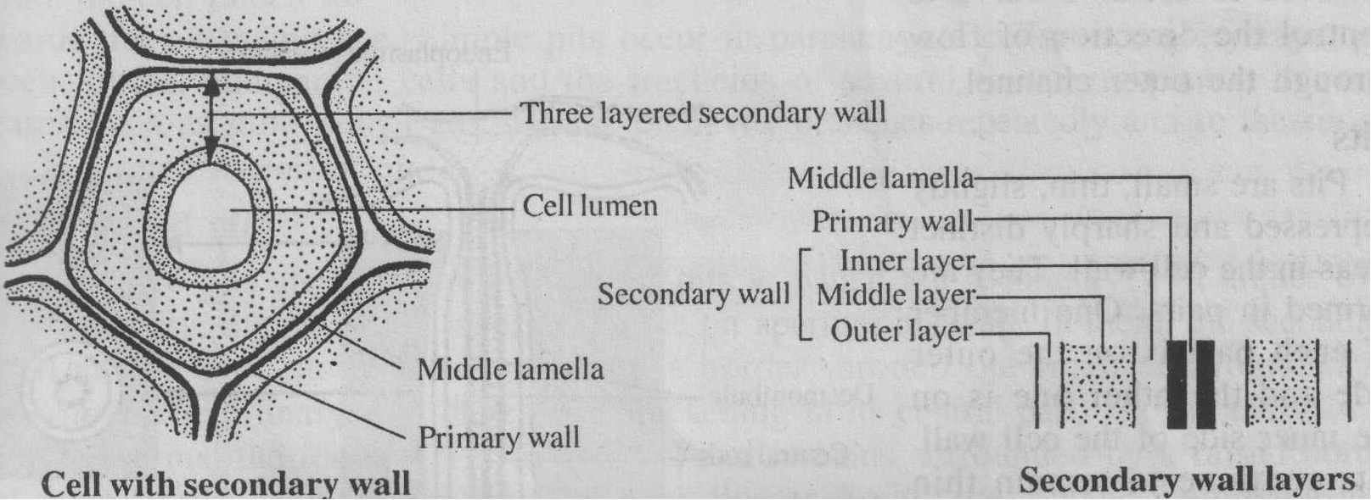

Slide 18
Plasmodesmata
Plant cell walls have numerous tubular openings and depressed areas, known respectively as plasmodesmata and pits.
They permit the free movement of substances between adjacent cells.
Usually, wall layers may not be formed in the regions of plasmodesmata.
Plasmodesmata are fine, tubular protoplasmic strands which pass through minute pores in the cell wall, connecting together the living protoplasts of adjacent cells.
Plasmodesmata maintain protoplasmic continuity within the plant body.
Cytoplasmic streaming between adjacent cells occurs through them.
As a result, the protoplasts of the numerous cells of a plant body form a continuous system, called symplast.
Notes:
They fill minute passages which constitute the only breaks in the primary wall.

Slide 19
Thus, the plant body is divisible into two major compartments, namely symplast and apoplast.
Symplast is the continum of cell protoplasts linked together by plasmodesmata.
On the other hand apoplast is the continum of non-protoplasmic matter and it includes cell walls, intercellular materials and intercellular spaces.
Plamodesmata are significant in that they bring about protoplasmic continuity, transport of materials and transmission of impulses.
Intercellular transport can be unidirectional or bidirectional, as the case may be.
But, it is not definitely known whether bidirectional transport is possible through the same plasmodesma.
In most plasmodesmata, there are two potential conducting channels, namely the outer cytoplasmic channel and the central desmotubule.
Desmotubule is believed to act as a valve to control the direction of flow through the outer channel.

Slide 20
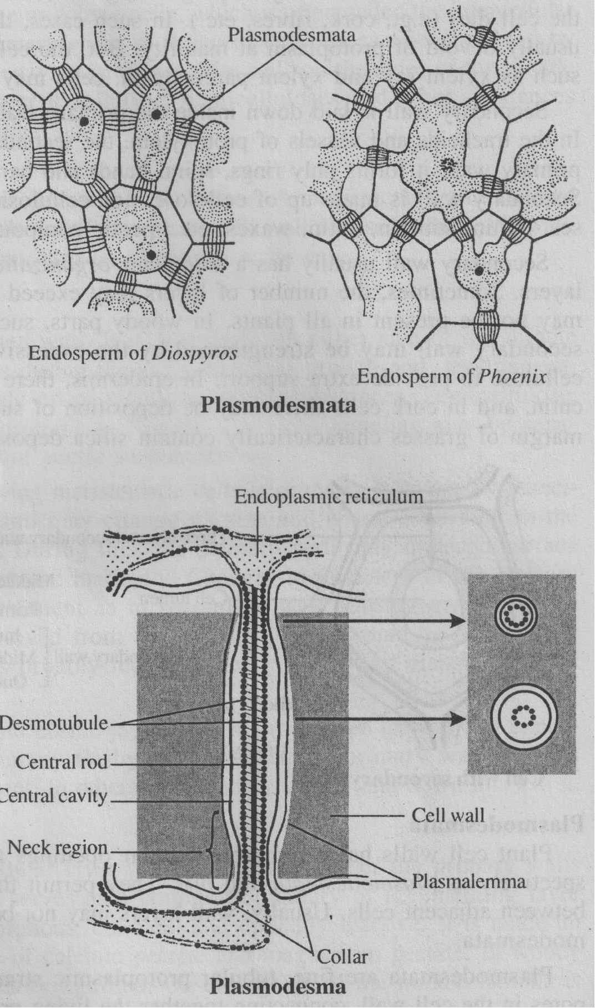

Slide 22
Pits .
Pits are small, thin, slightly depressed and sharply distinct areas in the cell wall.
They are formed in pairs.
One member of each pair is en the outer side and the other one is on the inner side of the cell wall.
Pits continue to remain thin while the rest of the wall goes I on thickening.
The thin walled area of a pit is called pit field.
It consists of a pit cavity or pit chamber and a pit membrane.
Pit cavity is the space within the pit field.

Slide 23
Pit membrane or closing membrane is the thin sheet of unbroken wall which separates the two pit cavities of a pit pair.
The opening of each pit chamber is called pit aperture.
A pit has thus two pit cavities, two pit apertures and one closing membrane.
The pit membrane is common to both the pits of a pit pair.
It consists of two primary walls and a middle lamella.
Usually, two types of pits are found in the cells of plants, namely simple pits and bordered pits.

Slide 24
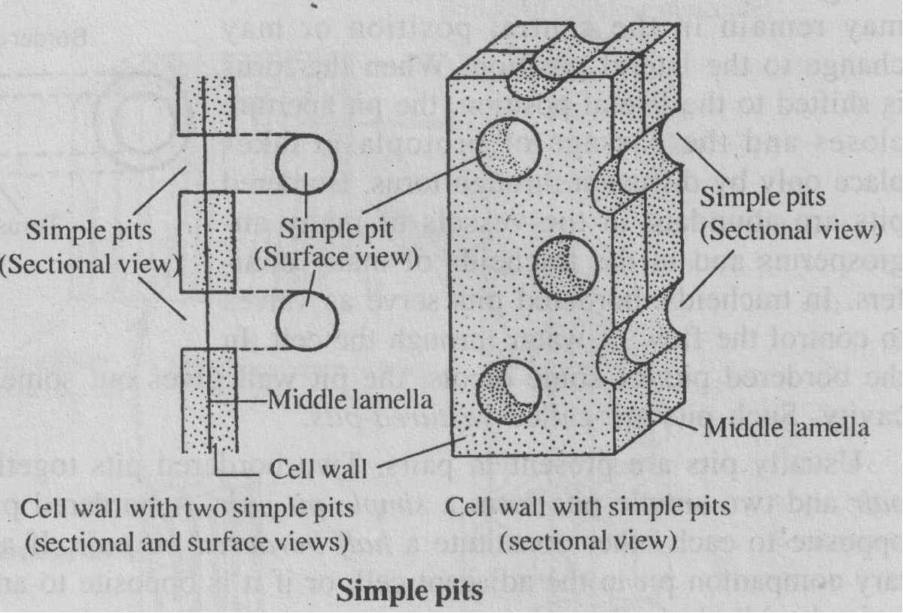

Slide 25
Simple pits
Simple pits are the pits in which the secondary wall does not arch over the pit cavity, the pit cavity has uniform diameter and the closing membrane is simple and uniform in structure.
They may be circular, oval, polygonal, or elongated in its facial view.
In thin walls, simple pits are shallow.
But, in thick walls, the pit cavity is seen as a canal passing from the cell Iumen towards the pit membrane.
Simple pits occur in parenchyma cells, medullary rays, phloem fibres, companion cells and the tracheids of several flowering plants.
In some cases, such as stone cells (sclerids), the pit cavity branches repeatedly and so the simple pit is termed ramiform pit.

Slide 26
2. Bordered pits Bordered pits are the complex type .
of pits in which the secondary wall arches over the pit cavity, the pit cavity is large and the pit aperture is small.
In them, the secondary wall arches over the pit cavity to form a border around the small and rounded pit aperture.
The primary wall develops a thickening in its central part, known as torus.
In gymnosperms, the torus is well developed and remains surrounded by a raised border of microfibrils, known as margo.
In many bordered pits, the closing membrane may change its position within pit cavities.
The torus may remain in the central position or may change to the lateral position.
When the torus is shifted to the lateral position, the pit aperture closes and the passage of protoplasm takes place only by diffusion through torus.

Slide 27
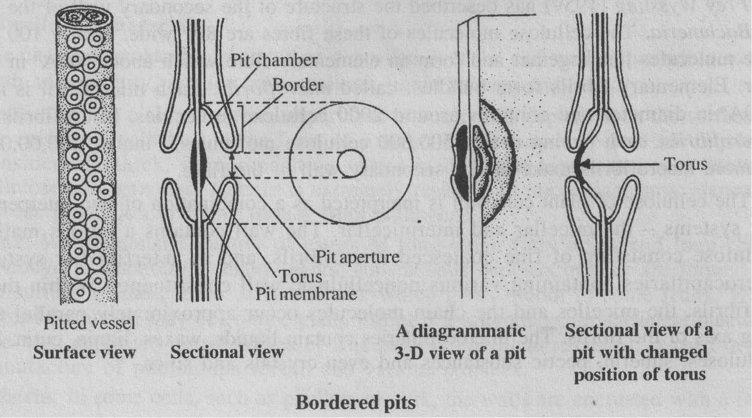

Slide 28
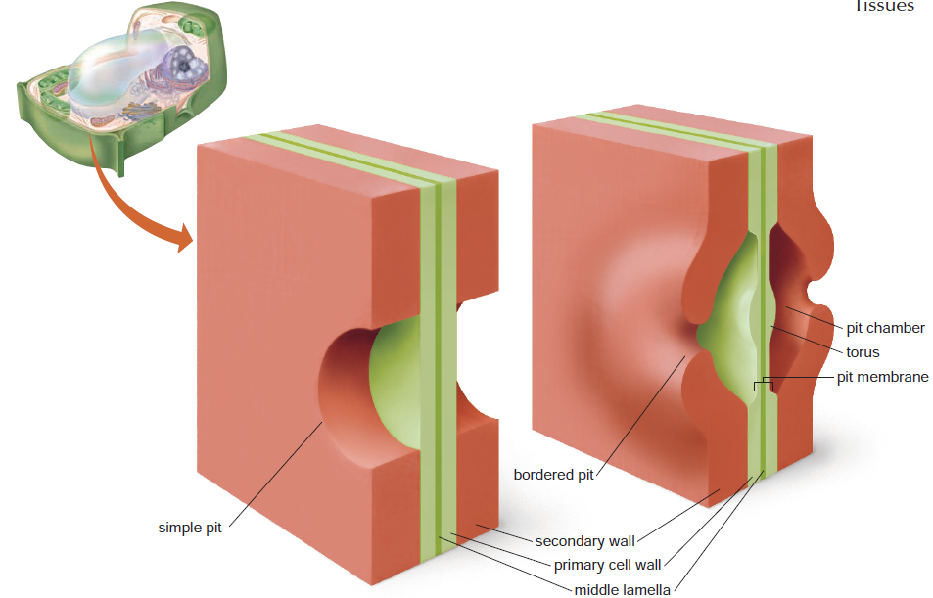
Notes:
Pits. Pits are depressions in cell walls where the secondary wall does not form. There may be from one or two to several
thousand in a cell. They often occur in pairs, with one on each side of the middle lamella. Some, called bordered pits (right), bulge out from
the wall and resemble doughnuts in surface view, while others, called simple pits (left), do not bulge

Slide 29
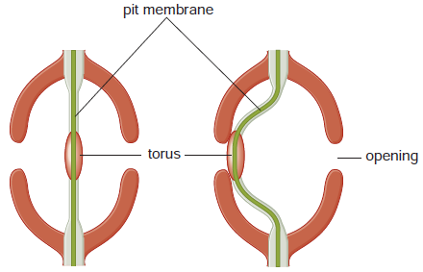
How water flow is controlled in adjacent pairs of bordered pits. The pits are separated by a pit membrane consisting of the middle lamella and two thin layers of primary walls. A. Water moves relatively freely through the pit openings and pit membrane when the torus (a thickened region of the pit membrane) is in the center. B. If the flexible pit membrane swings to one side so that the torus blocks an opening, water movement through the pit pair is restricted.

Slide 30
Bordered pits are abundant in the vessels of many angiosperms and in the tracheids of many conifers.
In tracheids, bordered pits serve as valves to control the flow of water through the cell.
In the bordered pits of some dicots, the pit wall gives out some outgrowths into the pit cavity.
Such pits are called vestured-pits.
Usually pits are present in pairs.
Two bordered pits together form a bordered pit pair and two simple pits form a simple pit pair.
A bordered pit and a simple pit lying opposite to each other constitute a half bordered pit pair.
If a pit has no complementary companion pit in the adjacent cell, or if it is opposite to an intercellular space, it is termed a blind pit.
Sometimes, two or more found opposite to a large pit.
This arrangement is called unilateral compound pitting.

Slide 31
Microscopic and submicroscopic structure of cell wall
Plant cell wall is composed mostly of cellulose.
Electron microscopic studies reveal that its fundamental structural units are chain-like cellulose molecules of different lengths
These chains are not dispersed, but occur in aggregations, generally known as micelles.
The chain molecules possess a parallel arrangement in a micelle and the glucose residues of each chain are spaced at uniform distance from each other.
The bundles of cellulose molecules are interconnected, forming a porous micellar system, which is interpenetrated by an intermicellar system.
In the intermicellar system, various wall substances other than cellulose are present.

Slide 32
Frey Wyssling (1959) has described the structure of the secondary wall of the fibres of Bochmeria.
The cellulose molecules of these fibres are 8Aº wide.
Nearly 100 cellulose molecules link together and form an elementary fibre which about 100 Aº in diameter.
Elementary fibrils form bundles, called microfibrils.
Each microfibril is nearly 250Aº in diameter and contains around 2000 cellulose molecules.
Microfibrils form macrofibrils, each having nearly 500,000 cellulose molecules.
Finally, 200,00,00,000 or more macrofibrils make up the secondary wall of the fibre.

Slide 33
Cellulose : Nature Working Across a Length Scale >10¹⁰!
Cellulose nanofiber bundles
6 assembly proteins (rosette) which produce cellulose nanofibers
~28nm
C. Haigler & L. Blanton
Notes:
Cellulose: You're surrounded by it, but did you know it was there? Where do we find cellulose, why is it important? Cellulose is all around us _ we wear it, eat it, build with it, print on it, burn it. And yet, who even thinks about it or knows what it is?
Cellulose is the most abundant renewable resource in the biosphere. It is estimated that plants synthesize ten-thousand-billion tons of it annually. Land plants all synthesize abundant cellulose. In addition, cellulose is made by many algae, a few bacteria (e.g. Acetobacter xylinum and Agrobacterium tumefaciens), some fungi, numerous protozoa and even by members of one marine vertebrate subphylum, the tunicates.
Cellulose occupies a dominant place in nature because it is the major structural component of the walls that surround plant cells (Fig. 1). These walls provide the structure and strength of plants, serving as an all-pervasive skeleton without which plants could not stand upright. The plant cell wall is often compared in terms of strength to reinforced concrete, with the cellulose filling the role of the reinforcing bars. However, unlike reinforced concrete, cell walls in growing tissues remain flexible to accommodate cell expansion and shape changes. These dynamic functions of growing cell walls are conferred by the orientation of cellulose and by breaking and reforming of chemical bonds between other wall polymers and cellulose. Other specialized cell walls in non growing plant tissues contain more cellulose and are thick and rigid; these help plants carry out important functions such as conducting water.

Slide 34
There is evidence that the cellulose microfibrils of conifer wood are assembled into aggregates in the region of 10–20 nm across .
In cross-section the wood cell wall is so dense that these microfibril aggregates are not readily visible, but they have been imaged by atomic force microscopy and electron tomography, which showed their structures to be somewhat irregular and interspersed to a limited degree with other polymers.
In SEM images of transversely fractured wood the fracture planes cut cleanly across each microfibril aggregate but also run between aggregates for short distances, giving a stepped topography.
In mechanical terms, therefore, the microfibril aggregate appears to be the basic cohesive unit of the dry wood cell wall in the sense that it does not readily fray into its constituent microfibrils during fracture.
The details like precise dimensions of microfibrils and their aggregates, the number of chains in each microfibril, the disposition of its component crystalline and noncrystalline fractions have been elusive.
The determination of microfibril diameters in wood has been addressed frequently by a variety of techniques, particularly wide-angle X-ray scattering (WAXS) and solid-state ¹³C NMR.
However each technique has drawbacks and agreement has not been generally good. Diameters suggested have ranged from 2.2 nm to 3.6 nm.
These upper and lower limits correspond to about 12 and 32 chains (πr2∕0.317) if it is assumed that the wood microfibrils are approximately circular in cross section
and each chain occupies 0.317 nm² as in cellulose Iβ

Slide 35
Nanostructure of cellulose microfibrils in spruce wood
Anwesha N. Fernandesa, Lynne H. Thomasb, Clemens M. Altanerc, Philip Callowd, V. Trevor Forsythd,e, David C. Apperleyf, Craig J. Kennedyg, and Michael C. Jarvish,1
“Our data suggest microfibrils with about 24 chains, possibly twisted and with considerable disorder increasing towards the surfaces. Less extensive disordered regions probably exist within the core of each microfibril. “
“Tight lateral binding is facilitated by the hydrogen-bonding pattern of the surface chains, at only a small cost in tensile stiffness due to the loss of intramolecular hydrogen bonding between O₂ and O_{6”}
PNAS ∣ November 22, 2011 ∣ vol. 108 ∣ no. 47 ∣ E1195–E1203

Slide 36
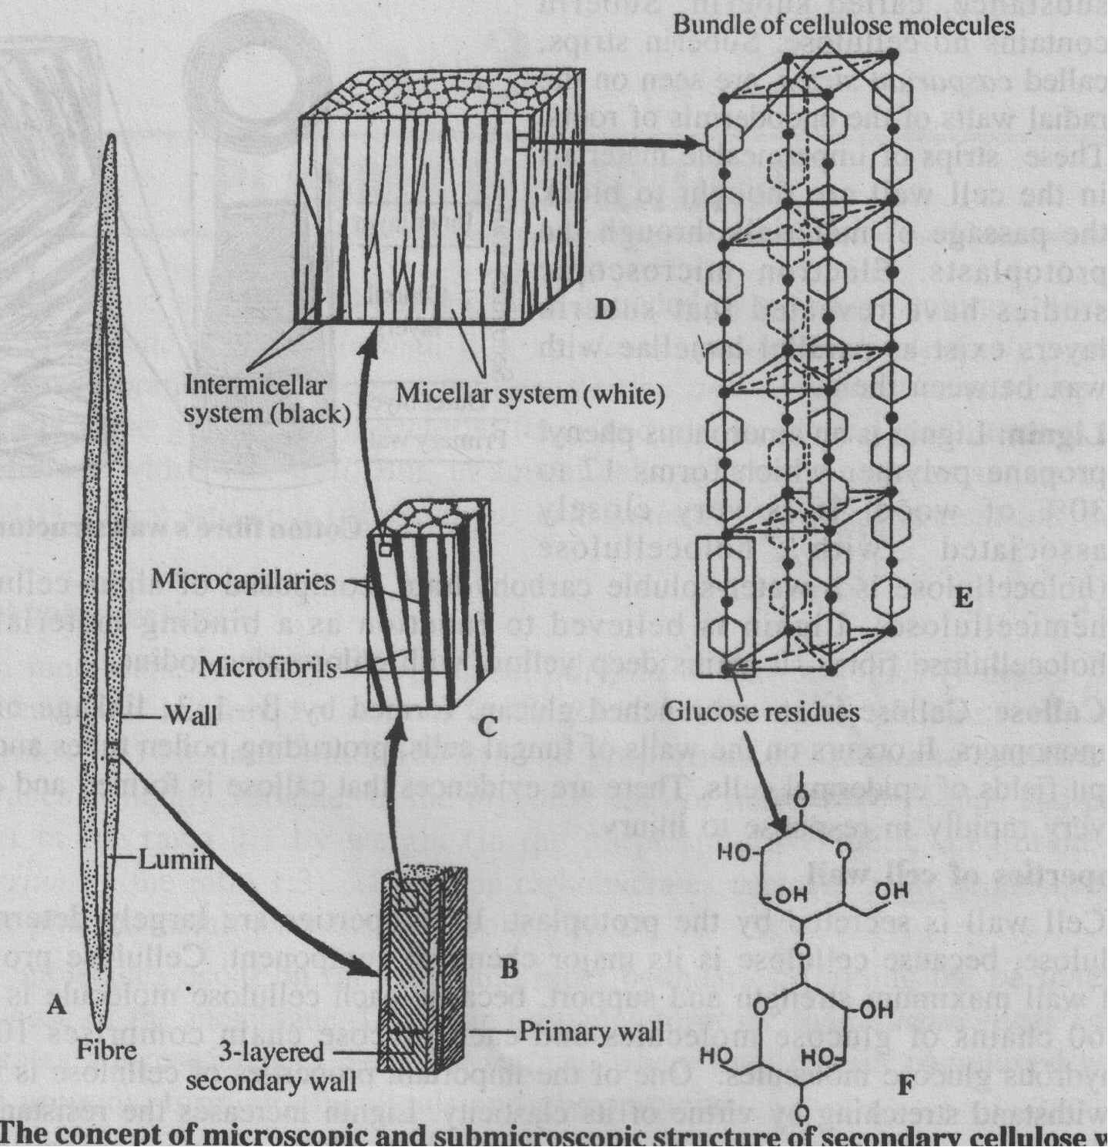

Slide 37
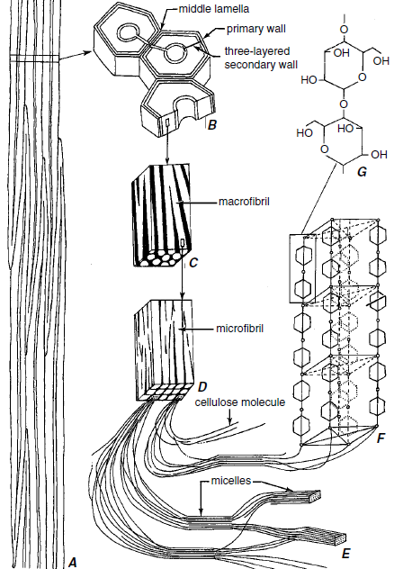

Slide 38
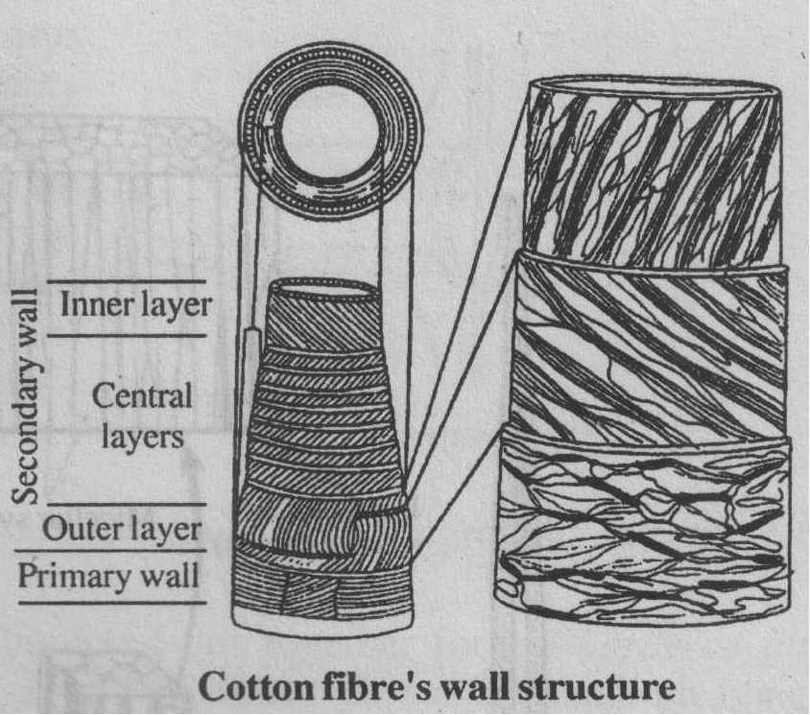

Slide 39
The cellulose of plant cell wall is interpreted as a combination of two interpenetrating systems - the micellar and intermicellar.
The wall contains a porous matrix of cellulose consisting of fine coalesced microfibrils, and an interfibrillar system of microcapillaries containing various noncellulosic wall constituents.
Within the microfibrils, the micelles and the chain molecules occur approximately parallel to the long axis of the fibrils.
The microcapillaries contain liquids, waxes, lignin, cutin, hemicelluloses, suberin, pectic substances and even crystals and silica.

Slide 40
Extra-cell wall materials
The chemical molecules, secreted or deposited over the cell wall to provide it extra strength and stability, include cutin, callose, lignin suberin and wax.
1. Cutin: Cutin is a fatty material, impervious to water.
It is deposited on the surface of the epidermal cell wall in the form of a layer, called cuticle.
When the cuticle is considerably thick, its composition varies in different layers and may include cellulose and wax also.
Cuticle is extremely resistant to microorganisms.
Hence, it affords protection to living tissues from pathogens.

Slide 41
2. Wax:
Waxes consist mainly of esters of long-chain fatty acids and long-chain monohydric alcohols.
In many plants, conspicuous deposits of wax are formed on the surface of the cuticle.
It is this wax which gives sheen to some fruits.
Wax, formed by plants, may be commercially useful if it is produced in sufficient quantity.
The wax, deposited on the leaves of wax palm (Copernicia cerifera), is used in the manufacture of photograph record and various polishes.

Slide 42
3. Suberin:
In some cells, such as phellem or cork, the walls are encrusted with a fatty substance, called suberin.
Suberin strips, called casparian strips, are seen on the radial walls of the endoderm is of roots.
These strips of impermeable materials in the cell wall are thought to block the passage of materials through the apoplasts.
Electron microscopic studies have revealed that suberin layers exist as parallel lamellae with wax between them.

Slide 43
4. Lignin:
Lignin is an amorphous phenyl propane polymer which forms 17 to 30% of' wood.
It is very closely associated with holocellulose (holocellulose is a water-soluble carbohydrate, composed of alpha-cellulose and hemicellulose).
Lignin is believed to function as a binding material for the holocellulose fibres.
It stains deep yellow with chloro-zinc-iodine.

Slide 44
5. Callose:
Callose is an unbranched glucan, formed by β -1, 3, linkage of glucose monomers.
It occurs on the walls of fungal cells, protruding pollen tubes and primary pit fields of epidermal cells.
There are evidences that callose is formed and deposited very rapidly in response to injury.

Slide 45
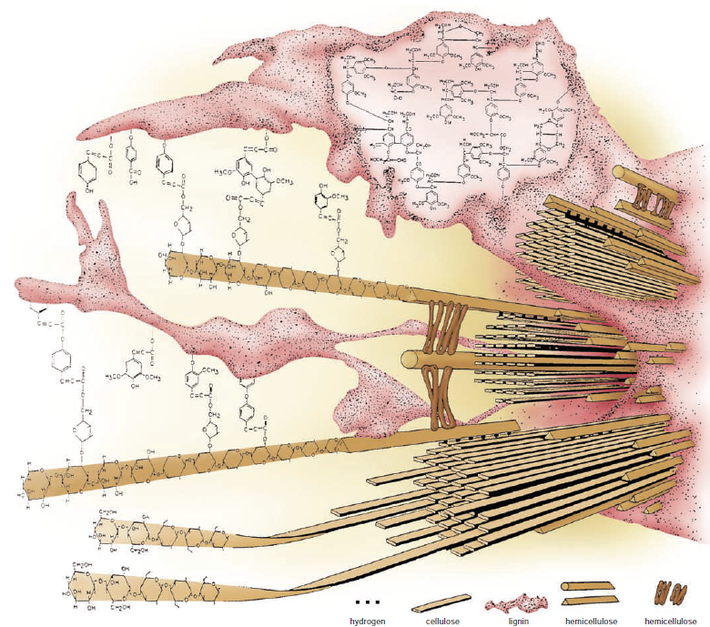
Secondary cell wall structure. Components are arranged so that the cellulose microfibrils and hemicellulose chains are embedded in lignin.

Slide 46
Properties of cell wall
Cell wall is secreted by the protoplast.
Its properties are largely determined by cellulose, because cellulose is its major chemical component.
Cellulose provides the cell wall maximum strength and support
One of the important properties of cellulose is its ability to withstand stretching by virtue of its elasticity.
Lignin increases the resistance of the wall against pressure and thus prevents the folding of the cellulose microfibrils.
The orientation of the microfibrils in the different lamellae of the wall is an important factor in determining the strength of the wall.
Notes:
because each cellulose molecule is made up of 60 chains of glucose molecules and each glucose chain comprises 1000-3000 anhydrous glucose molecules.

Slide 47
Functions of cell wall
Cell wall is an active functional component of plant cells.
Some of its major functions are the following:
Provides support to the cell and protects the protoplatst from lysis.
Prevents dehydration and enables the aerial existence of plants.
(iii) Forms a protective barrier against pathogens and injuries.
(iv) Determine the form and shape of the cell and regulates its growth.
(v) Serves as a freely permeable route for the movement of materials into and out of the cell.
(vi) Resists the osmotic pressure exerted by the cell contents.
(vii) Actively participates in growth, differentiation and cellular recognition.
(viii) Serves as a centre of enzyme activity.

